Slide 1

#HACK 19 challenge - Stack overflow
Team Name: DART VADERS
Team Members:
Akshay Kharche
Anuradha Kumari
Pavankumar Patil
Rahul Bhavsar
Ruchi Sharma

Slide 2
Introduction to Widgets
Theme: Stack overflow
Implementation:
splash screen
Landing page
Contains list of questions sorted by newest date
Integrated with stack overflow api
Details viewed: vote count, answer count, view count
Implemented drawer
Tech stack:
Dart
Flutter
Github link - https://github.com/akshaykharche/dart_vaders_hack19_stack_overflow

Slide 3
Introduction to Widgets
Upcoming features
Speech recognition to search questions
User profile integration
Search questions by tags
Github link - https://github.com/akshaykharche/dart_vaders_hack19_stack_overflow

Slide 4
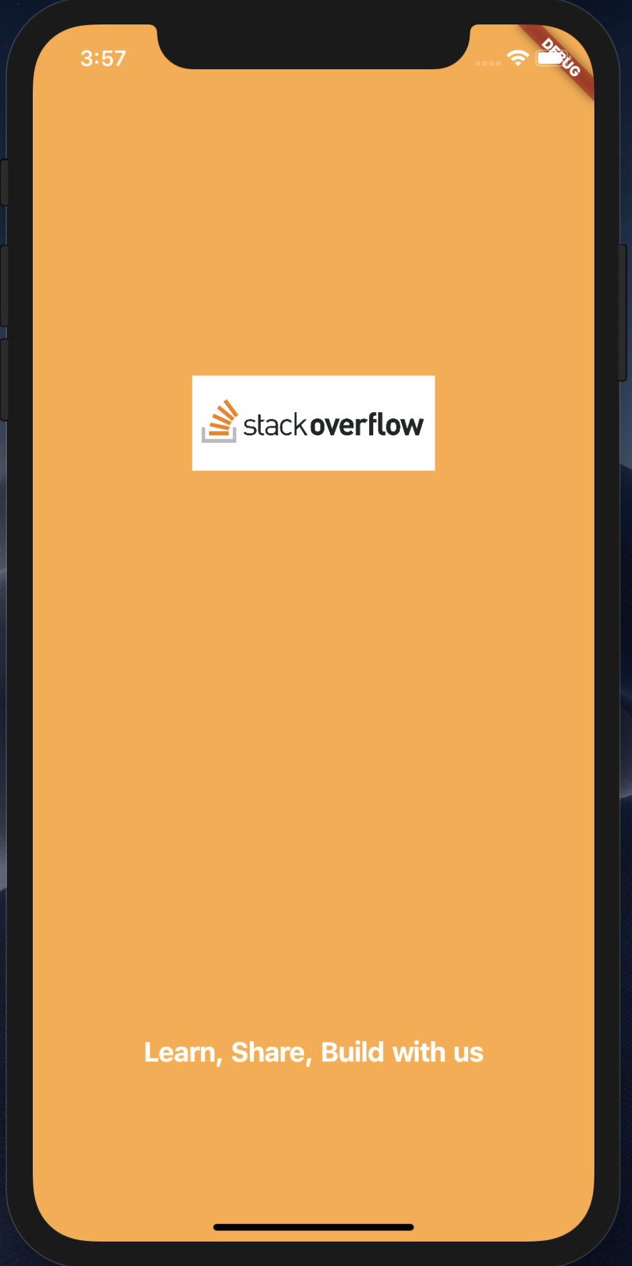
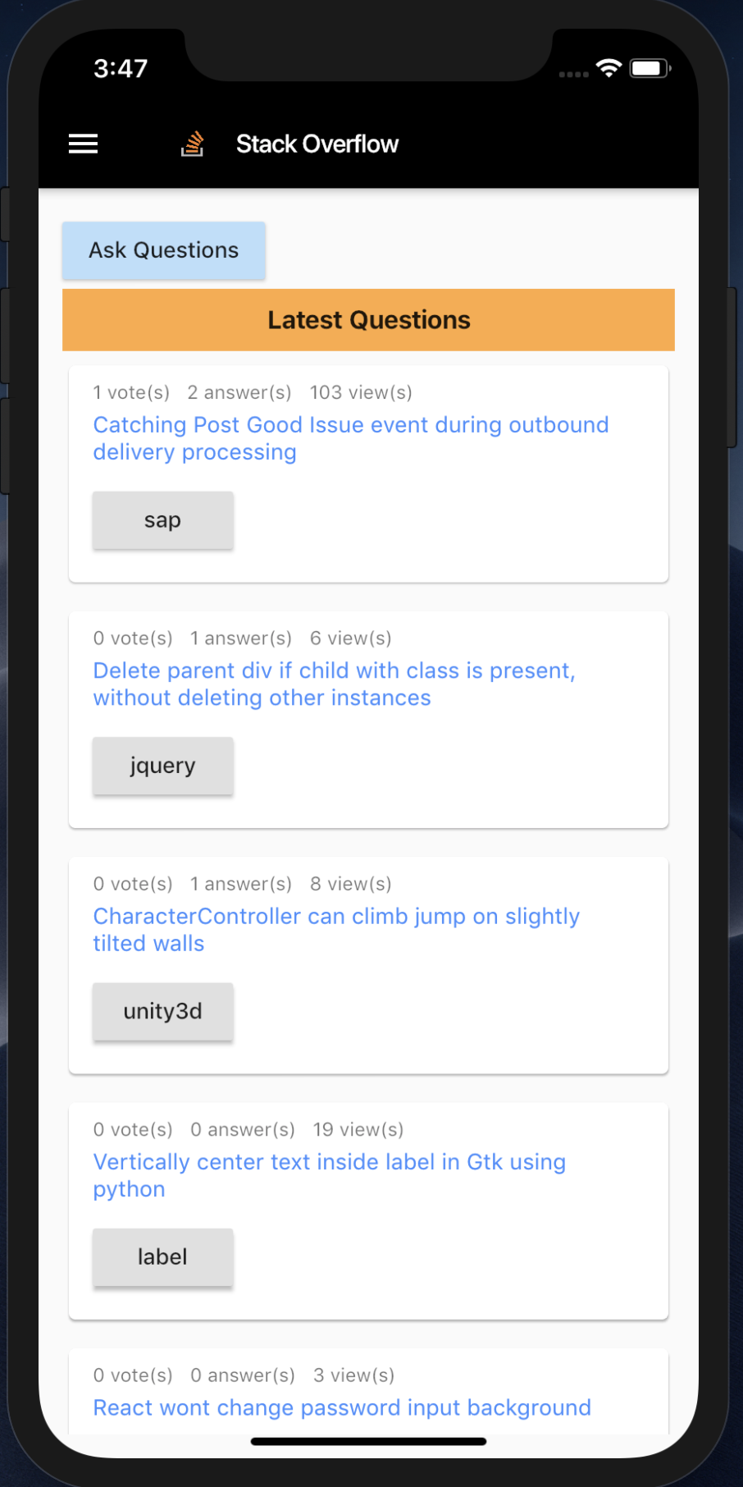
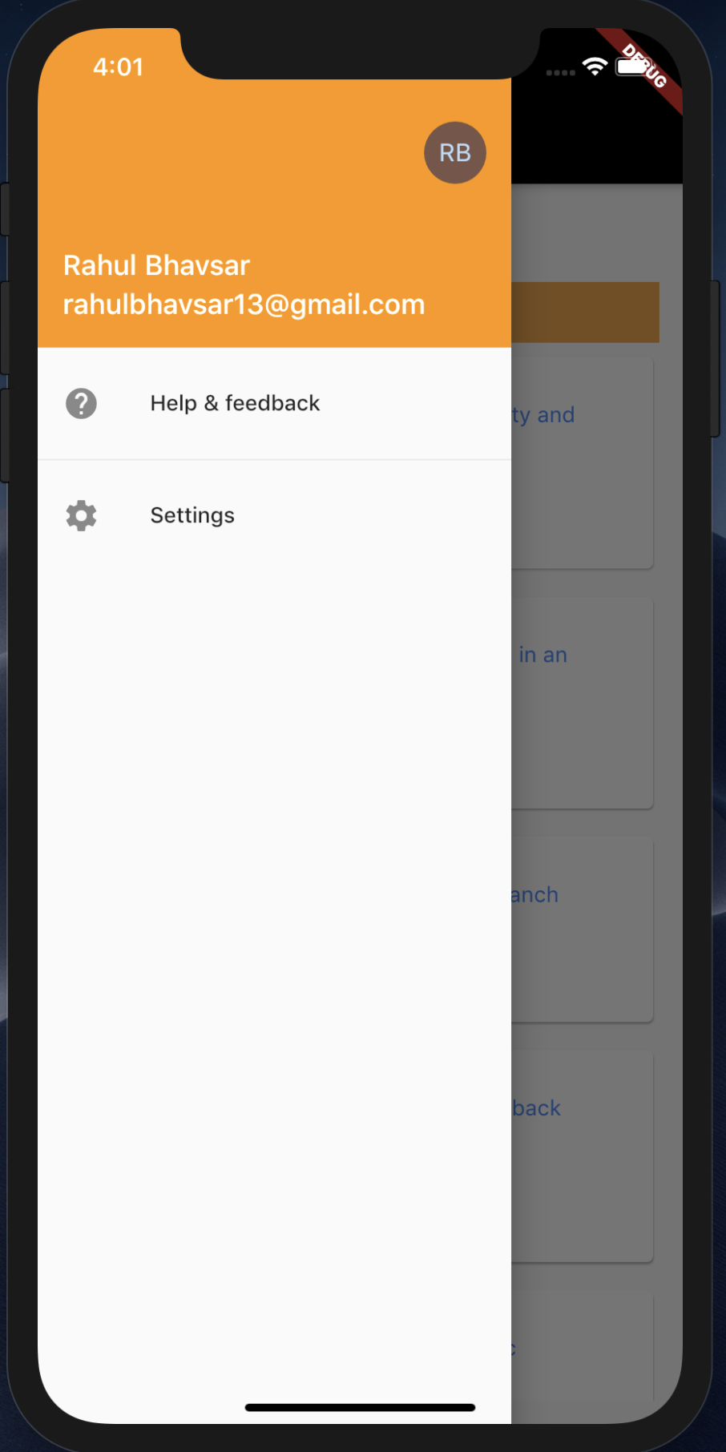
Introduction to Widgets
Screens

Slide 5
Introduction to Widgets
Thank You!!

